Slide 1
Time Series forecasting Part IV

Slide 2
Data preparation for forecasting

Slide 3
Preprocessing of Data
All predictive modeling require preprocessing of data to improve predictive accuracy
For example if there are missing observations in the data or if a few unusual observations are there in the data, a decision needs to be taken how to handle them
To quantify predictive power of a model, an out-of-sample model validation is necessary
Objective of this lesson is to
Indicate a few simple steps for data preprocessing
Setting up model validation procedure
Decide on appropriate method for forecast

Slide 4
Missing Data
Since TS data is ordered, no missing data is allowed
It is simply not possible to shift the series to fill in the gaps

Slide 5
Missing Data
Suppose a few data points are missing
Shoe sales
May
Feb

Slide 6
Missing Data
Shifting series destroys the pattern
Take average of nearest neighbors

Slide 7
Missing Data
If the data has no seasonality, then this method works
For seasonal data simplest method is to take average of the seasons from two neighboring years or from all available years

Slide 8
Unusual Observations
Detection of outliers in time series is difficult
If trend is present in the data, then usual method of detecting outliers by boxplot may not work
If seasonality is present in the data, one particular season’s data may be too small or too large compared to the others
Decomposition helps in identifying unusual observations
If trend and seasonality are not adequate to explain the observations
Outliers cannot be eliminated – they need to be imputed as closely as possible by using the knowledge gained from decomposition

Slide 9
Model Validation
Predictive power of a model is estimated by comparing its forecasting performance on a Test Data
A part of sample data is used to train (develop) the model: Training Data
A part of sample is withheld from estimation process: Test Data
The model which gives smallest measure of error between forecast and actual series is the ‘best’

Slide 10
Model Validation
Training Data is used to identify a few working models
The forecasts for training data are called fitted values
Each of the models is tested against the observed values of the series for hold-out period
The model is selected to be the best where observed and forecasted values are the closest

Slide 11
Model Validation
For other predicting models hold-out sample is randomly chosen from the total sample
Usually in 80:20 ratio
For time series hold-out sample has to be the most recent period because of the ordered nature of the data
Training Data
Test Data

Slide 12
Model Validation
If there is seasonality in the data, the at least one full season’s data need to be held out for validation
Once a model is selected, held-out period must be incorporated into the sample for final forecasts for future

Slide 13

Measures of Forecast Accuracy
Performance of forecast method is tested by comparing the forecast values with the test sample observations
$$\hat{Y(t)}$$
Forecast Values
Y(t)
Observed Values
Compare the observed and forecast values through
various methods

Slide 14
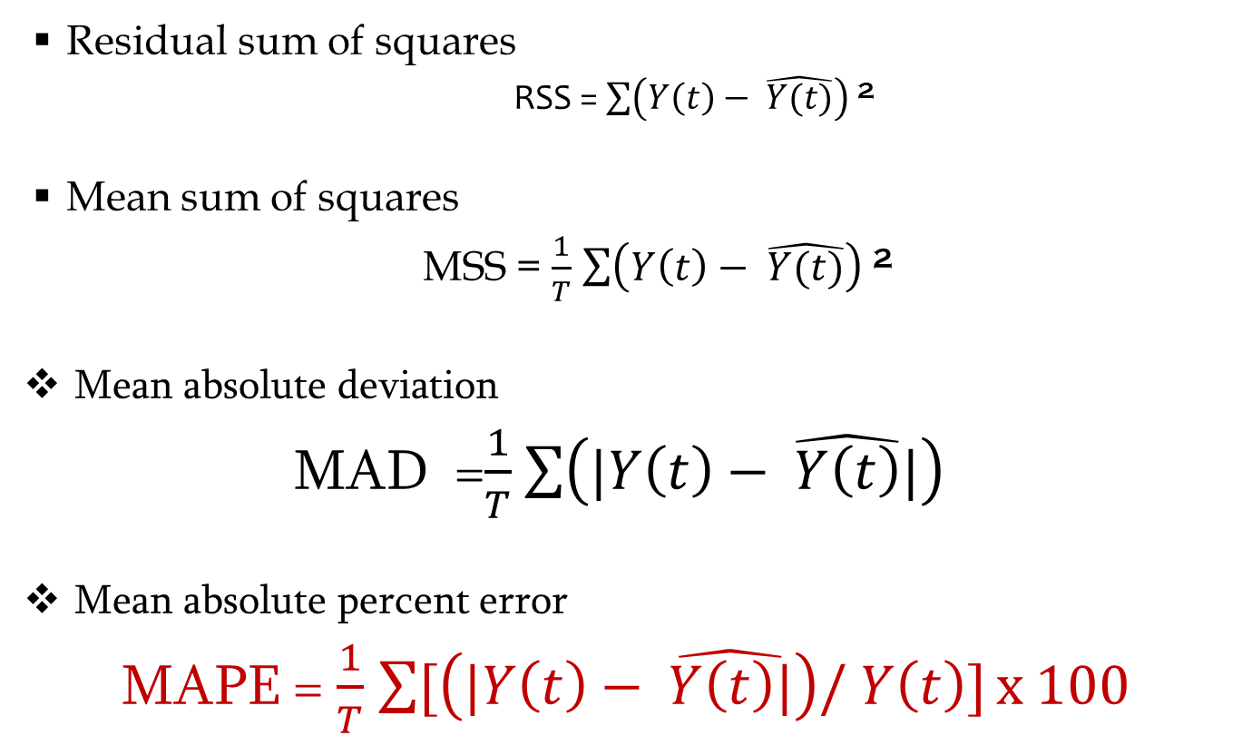
Measures of Forecast Accuracy
Residual sum of squares
RSS = $\sum{\left(Y\left(t\right)− \hat{Y(t)}\right) }$²
Mean sum of squares
MSS = $\frac{1}{T}$ $\sum{\left(Y\left(t\right)− \hat{Y(t)}\right) }$²
Mean absolute deviation
MAD =$\frac{1}{T}$ $\sum{\left(|Y\left(t\right)− \hat{Y\left(t\right)}|\right) }$
Mean absolute percent error
MAPE = $\frac{1}{T}$ $\sum{[\left(|Y\left(t\right)− \hat{Y\left(t\right)|}\right)/}$ $Y\left(t\right)]$ x 100

Slide 15
Example: Forecast Income
54 quarter’s data: 2000Q4 – 2014 Q1
Hold-out period: Last 5 quarters 2013 Q1 onwards
Divide data into 2 parts using window()
IncomeTrain <- window(Income, start=c(2000,4), end=c(2012,4), frequency=4)
IncomeTest <- window(Income, start=c(2013,1), frequency=4)
Use IncomeTrain to forecast for 5 future periods

Slide 16
Example: Forecast Income
Use R library fpp2
forecast()
Use a naïve method based on decomposition to forecast for the Test period
IncTrn7<-stl(IncomeTrain, s.window=7)
fcst.Inc.stl <- forecast(IncTrn7, method="rwdrift", h=5)
Vec<- cbind(IncomeTest,fcst.Inc.stl$mean)
ts.plot(Vec, col=c("blue", "red"), main="Quarterly Income: Actual vs Forecast")
MAPE <- mean(abs(Vec[,1]-Vec[,2])/Vec[,1])
MAPE
Notes:
https://www.youtube.com/watch?v=ouahL4HbwBE
To see what is RW with drift

Slide 17
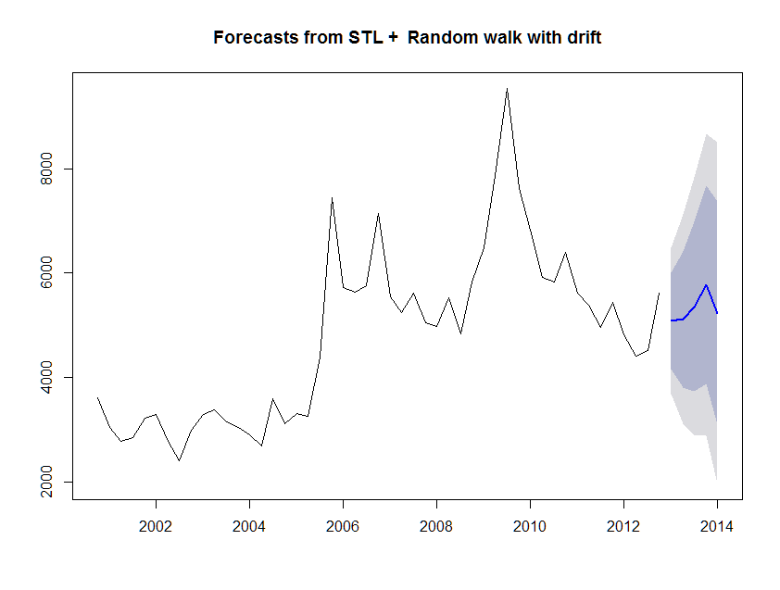
Example: Forecast Income

Slide 18
Example: Forecast Income
Year | Quarter | Actual Income | Forecast Income
2013 | Q1 | 5505 | 5082.005
2013 | Q2 | 5122 | 5110.556
2013 | Q3 | 5633 | 5354.427
2013 | Q4 | 6793 | 5775.767
2014 | Q1 | 5130 | 5233.772
MAPE = 6%

Slide 19
Example: Forecast Income
Since MAPE value is acceptable use the model to forecast for 2014 Q2 – Q4 and 2015 Q1-Q4
Use full available series for final model
Forecast for 7 future periods
 |  | Point Forecast
2014 | Q2 | 5058.604
2014 | Q3 | 5301.108
2014 | Q4 | 5995.556
2015 | Q1 | 5273.617
2015 | Q2 | 5202.222
2015 | Q3 | 5444.725
2015 | Q4 | 6139.173

Slide 20
Example: Forecast Income (Test)

Slide 21
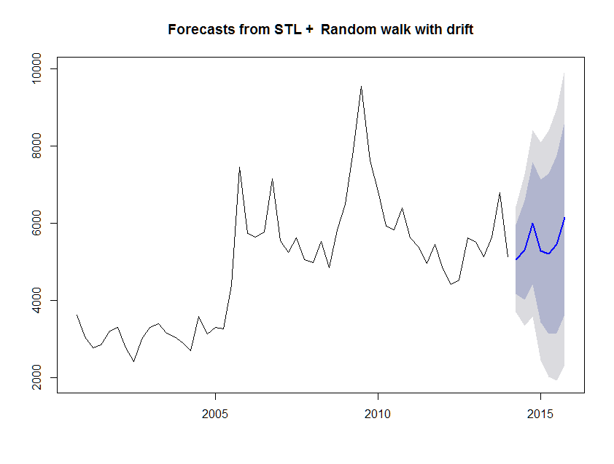
Example: True Forecast Income

Slide 22
Next Step: Methods for Forecast
Once the data is ready and decision has been taken on setting up training and test periods
Appropriate forecast model is considered
Naïve Decomposition Method of forecast works remarkably well for many financial and economic time series
Other important methods are
Exponential smoothing
Autoregressive methods

Slide 23
Thank You

